Slide 1

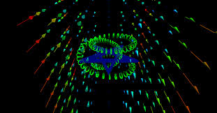

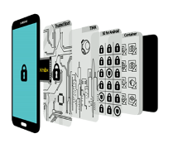
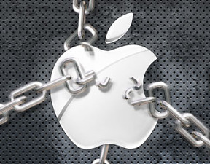
Digital Credentials and Disruptive Technologies
Bill Edwards, USN
The hardware foundations for simple and strong authentication

Slide 2

It has been said that the door of history turns on small hinges . . .

Slide 3
The complexity of today’s Internet environment means . . .
Providing exceptional access to communications would force a U-turn from the best practices now being deployed to make the Internet more secure. These practices include forward secrecy—where decryption keys are deleted immediately after use, so that stealing the encryption key used by a communications server would not compromise earlier or later communications. A related technique, authenticated encryption, uses the same temporary key to guarantee confidentiality and to verify the message has not been forged or tampered with.

Slide 4
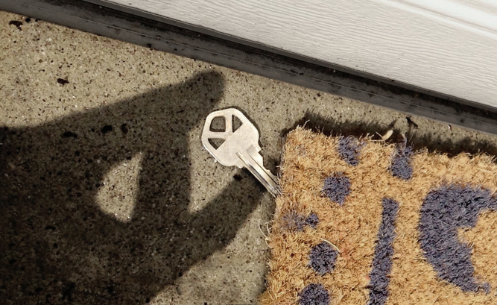
Complexity is the enemy of security—every new feature can interact with others to create vulnerabilities.
Notes:
Recent attacks on the U.S. Government Office of Personnel Management (OPM) show how much harm can arise when many organizations rely on a single institution that itself has security vulnerabilities. In the case of OPM, numerous federal agencies lost sensitive data because OPM had insecure infrastructure. If service providers implement exceptional access requirements incorrectly, the security of all of their users will be at risk

Slide 5
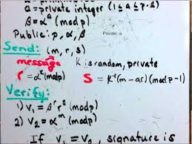
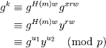
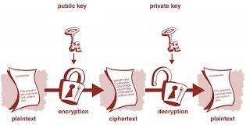
The greatest impediment to exceptional access may be jurisdiction
The need to grapple with these legal and policy concerns could move the Internet overnight from its current open and entrepreneurial model to becoming a highly regulated industry. Tackling these questions requires more than our technical expertise as scientists and engineers, but they must be answered before anyone can embark on the technical design of an exceptional access system.
Notes:
Google’s database of surveillance targets was surveilled by Chinese agents who hacked into its systems, presumably for counterintelligence purposes. Our analysis applies not just to systems providing access to encrypted data
but also to systems providing access directly to plaintext. For example, law enforcement has called for social networks to allow automated, rapid access to their data. A law enforcement back door into a social network is also a vulnerability open to attack and abuse.

Slide 6


The DoD needs to account for the risks inherent in exceptional access systems
In the wake of the growing economic and social cost of the fundamental insecurity of today’s Internet environment, any proposals that alter the security dynamics online should be approached with caution. Exceptional access would force Internet system developers to reverse forward-secrecy design practices that seek to minimize the impact on user privacy when systems are breached.

Slide 7

Writing Code
For instance, OpenSSL, the software used by about two-thirds of websites to do TLS encryption, has been plagued with systems-level bugs resulting in catastrophic vulnerabilities. Introducing complex new exceptional access requirements will similarly add more security bugs that will lurk in our software infrastructure for decades to come.

Slide 8

A theory must be proved experimentally to enter the book of knowledge.
But what requirements must an untested theory meet to be considered scientific? Theorists guide the scientific enterprise by dreaming up the ideas to be put to the test and then interpreting the experimental results; what keeps theorists within the bounds of science?

Slide 9
DoD Digital PKI credentials
NIST has coined the term derived credentials to refer to cryptographic credentials that are derived from those in a Personal Identity Verification (PIV) card or Common Access Card (CAC) and carried in a mobile device instead of the card. (A CAC card is a PIV card issued by the Department of Defense.) In other words, a derived credential is a new credential that leverages identity proofing and vetting results of current valid PIV card to receive a derived PIV credential. To achieve interoperability a derived credential is a PKI credential. The two different approaches of using digital credentials on phones and tablets are primary and derived credentials. FIPS 201 defines the procedures for a PIV lifecycle including identity proofing, registration, PIV card issuance and usage. FIPS 201 explains that the identity credentials must be stored on a smart card. NIST SP 800-73-3 infers the technical specs to interface with the smart card to retrieve and use the identity credentials. The primary credential on a CAC or PIV can be read or transferred directly to the device or tablet using either a card reader or NFC. The Derived PIV Credential is a PIV Derived Authentication certificate, which is an x509 public key certificate that has been issued in accordance with the requirements of this document and the x509 Certificate Policy for the U.S. Federal PKI Common Policy Framework.

Slide 10
Challenges within the DoD
One of the main challenges of using derived credentials on mobile devices is actually the result of one of the strengths in the mobile architecture. Applications on a mobile device are installed independently of other mobile applications. Each mobile application exists in a virtual sandbox, separated from the other applications installed on the same device. This is contrary to the shared memory space of a traditional desktop computer. At the time of brief, there are no known exploits that can penetrate this sandbox for an unauthorized application to gain access to other installed applications. For this reason, mobile applications can often be made more secure than their traditional desktop counterparts.

Slide 11
DoD Architectural Elements of Digital Credentials
“Switch”
(Universal Credential Storage)
Credential Generation
Apps
PC
Server / cloud
Smart Card (CAC/PIV)
Mobile device
Enrollment
Credential-consuming
Web browser
VPN client
Email client
Other
Physical Channel for
PKI Enrollment
Credential Storage
Physical Channel for
App Usage
iOS/Android Key Store (native)
TrustZone
Embedded Secure Element
Smart card (CAC/PIV)
TCP/IP
Camera
NFC
USB
Public network
Intranet
Blue Tooth
NFC
USB
Plug-Ins
Plug-Ins

Slide 12
DoD PKI Illustrative Use Cases
USB side-loading of credentials – Users put a digital credential on the mobile device via a side-loading procedure from USB
External contact card reader – Users plug the mobile device into a CAC reader via a sleeve or dongle. Samsung integrates BAI CAC readers into our email and browser applications. 3rd party vendors for the CAC readers may provide proprietary apps that use the credential from the card, or may require the user to select the right credential from the card prior to using the app.
Phone as NFC CAC/PIV reader – This option eliminates the 3rd party reader, and assumes that the phone becomes a reader for the NFC-enabled CAC/PIV.
Phone + NFC card create derived credentials – The phone and NFC CAC/PIV authenticate with each other and cooperate to generate a derived credential that applications know how to use. Validation of the card/phone/user occurs at the enterprise level.
Cloud or server enrolls phone using CAC or PIV and a PC enrollment station – The user goes to an enrollment station (PC) and enters user data. The data is sent to a server which centrally generates a digital certificate. The server sends a QR code to the PC screen which contains a One Time Password (OTP) and URL. The user opens an enrollment app, snapshots the QR code, and enrolls the phone.
Soft certificates – The user obtains a soft certificate from a central server. The credential is not derived from a CAC or PIV card, but is unique to the user and the device.

Slide 13
Storage Options
OPTION | PRO | CON | COMMENTS
Android Key Store | Universally available across all Android devices | Crypto operations are in the Normal World | Native to Android Framework
Trust Zone | Hardware-backed cryptographic and security operations and data | Premium space ($); High security means special access methods | CCM is a Trust Zone application on Samsung devices that manages asymmetric keys; TIMA Keystore manages symmetric keys
eSE | Independent tamper-resistant chip Can create secure domains accessible only by the key owner | Most valuable storage real-estate on the platform ($$) Provisioning and life cycle management of a secure domain will require special infrastructure | eSE plug-in available on Samsung devices eSE available on iOS devices
NFC CAC or PIV | All employees have a card Compatible with existing processes and infrastructure | May require continuous or multiple contacts with the device to accomplish a task | CAC/PIV plug-in available on Samsung devices

Slide 14
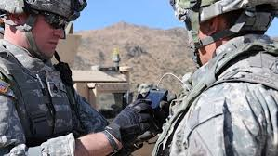
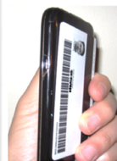


Perspective of DoD Credentials
Advocates
 | Use Enrollment Center Controlled access facility Proof of person & card Fill out forms Human assist with enrollment | DISA Purebred
 | Use Primary Credentials NFC-enabled card Phone as CAC/PIV reader Can use processor on card or: Use card to enroll digital credentials | DMDC
 | Use Soft Certificates Assumes identity data resides in data center (Account) Use out-of-band comms to send OTP and authentication process | DARPA Army (discussions) Navy (discussions with SPAWAR)
User Perspective
Comments
PROS:
Positive human ID
Positive phone ID
Positive card ID
Physical control of
enrollment space
CONS:
Expensive in terms of
people, facilities, IT
infrastructure
Requires travel and time to enroll and maintain
PROS:
Positive card ID
Reduces people,
facilities, IT costs
Reduces travel and time
CONS:
Requires NFC-enabled cards (new contract)
May require tapping card for every transaction
(depends on approach)
PROS:
Positive person ID
Reduces people,
facilities, IT costs
Reduces travel and time
Best supports BYOD
and COPE models
CONS:
Requires out-of-band
communications to
share secrets
Requires vendor app to
remotely interrogate
phones

Slide 15
‘Marketecture’ View of DoD Use Cases
‘Marketecture’ = Market + Architecture
KEY
Channel
Credential
App
PHYS CHANNEL
CREDENTIAL GENERATION
CREDENTIAL STORAGE
CONSUMING APPS
3rd Party Apps
Use Cases: (DoD only) or (Broader market)
Smart Card
Web Browser
Cloud Web Apps
PIV or CAC
microSD
Email client
VPN Client
Camera
Phone
WiFi
TCP/IP
Cloud
Server
eSE
UICC
USB
AKS
TZ
NFC
PC
USB side-loading of credentials
External contact card reader
Phone as NFC CAC/PIV reader
Phone + NFC card create derived credentials
Cloud or server enrolls phone using CAC or PIV
and PC enrollment station and cloud
Soft certificates
Approaching this from the broadest
market gets us:
PHYS CHANNEL
Credential Generation
Credential Storage
Consuming Apps
Physical channel used to obtain credential
Credential generated on phone from phone-smart card interaction

Slide 16
DoD Digital Credential Solutions and Markets
Priority | Solution | Market | Implementation Cost | Sustainment Cost
1 | Soft Certificates | Financial services, health care, insurance, small-medium businesses, some government organizations, including local government and law enforcement | Low | Low
2 | Generate derived credentials on the phone using NFC smart card | DoD, transportation/logistics, defense contractors, national ID cards | Medium Requires maintaining cards | Medium Requires maintaining cards
3 | USB Side Loading | DoD PKI | Medium Complex procedure Requires admin/IT support | High Requires significant admin/IT support
4 | Enrollment Station | DoD PKI | High Travel time for user; Admin time for enroller Requires maintaining cards | High Inconvenience and travel cost if card is lost; Significant admin/IT support Requires maintaining cards
5 | Phone as NFC CAC/PIV reader | DoD | Medium Requires maintaining cards | Medium- cards There is an “irritation cost” if user must continuously tap phone with card Requires maintaining cards
6 | External contact card reader | DoD | Highest Requires maintaining cards + readers for each phone | Highest Requires maintaining cards + readers for each phone Requires significant admin/IT support

Slide 17
Scientific Emphasis
What | Why | Comments
DEVICE-GENERATED CERTIFICATES Generation of digital certificates on the mobile device | This method is more secure than centralized generation and distribution | Certificates should attest to the authenticity of the user, the device, and (if used) the smart card
CARD-DEVICE MUTUAL AUTHENTICATION Mutual authentication between the NFC card and the mobile device | This reduces the risk that the card or the mobile device has been tampered with | If we can simultaneously authenticate card, phone and user, and generate credentials on the device that can be validated at the enterprise level, then users should be able to purchase devices anywhere in the world and securely enroll them into the PKI
MDM-INDEPENDENCE Centralized generation of digital certificates should work independently of an MDM | The DoD requires it Binding certificates to an MDM will make it very difficult to transition to a different MDM | Samsung/SSC LANT - Navy can create (and sign) enrollment applications which manipulate the MDM APIs
AUTOMATED INSTALLATION AND USE Once the certificate is generated, it should “just work” with native Samsung apps in a KNOX container; User decisions and actions should be very minimal | A complex implementation requiring user decisions will degrade the user experience and reduce sales | The KNOX container for an enterprise will be created by an MDM for a specific network domain, and therefore should determine which certificate is used by which app, based on container context

Slide 18
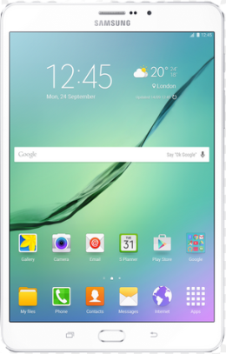

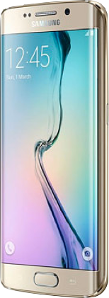

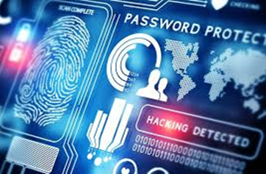

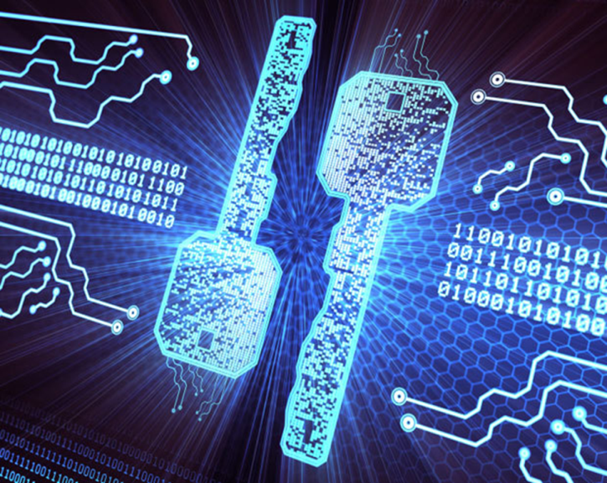
Open Standards and Global Platform Alliance
c = ENCRYPT (m) = m^{e} mod n
s = SIGN (m) = m^{d} mod n
m = DECRYPT (c) = c^{d} mod n
m = VERIFY (s) = s^{e} mod n

Slide 19


Slide 20
Key Generation
The security of deployed asymmetric cryptographic schemes relies on the believed hardness of number theoretic problems such as integer factorization and the computation of discrete logarithms in finite fields or in groups of points on an elliptic curve. However, most real-world cryptographic vulnerabilities do not stem from a weakness in the underlying hardness assumption, but rather from implementation issues such as side channel attacks, software bugs or design flaws.
An elliptic curve public key is a point Q = dG which is a multiple of the generator G for 1 d < n. Poor randomness might manifest itself as repeated values of d, and thus repeated public keys observed in the wild. In contrast to RSA, where poor random number generators and bugs have resulted in distinct RSA moduli that can be factored using the greatest common divisor algorithm when they share exactly one prime factor in common, an elliptic curve public key appears to have no analogous property.

Slide 21
RSA and DSA public-key cryptosystems
A DSA signature consists of a pair of integers (r; s) : r = g^{k} mod p mod q and
s = (k⁻¹(H(m)+xr)) mod q, where k is a randomly chosen ephemeral private key and H(m) is the hash of the message. DSA is a public key which consists of three so-called domain parameters (two prime moduli p and q and generator g of the subgroup of order q mod p) and an integer y = g^{x} mod p, where x is the private key.
An RSA public key consists of two integers: an exponent e and a modulus N. The exponent can be shared among multiple public keys without compromising security, but the modulus cannot. The modulus N is the product of two randomly chosen prime numbers p and q . The private key is the decryption exponent
d = e⁻¹ mod (p - 1)(q - 1):
Anyone who knows the factorization of N can efficiently compute the private key for any public key (e, N) using the preceding equation. When p and q are unknown, the
most efficient known method to calculate the private key is to factor N into p and q and use the above equation to calculate d.

Slide 22



Vulnerabilities
TLS certificate information—predominately the X509 subject and issuer fields. In many cases, the certificate identified a specific manufacturer or device model. Other certificates contained less information; we attempted to identify these devices through Nmap host detection or by inspecting the public contents of HTTPS sites or other IP services hosted on the IP addresses.
https://pentest-tools.com/network-vulnerability-scanning/tcp-port-scanner-online-nmap

Slide 23
More notes from NIST 800-57
Randomness is essential for modern cryptography, where security often depends on keys being chosen uniformly at random.
RSA and DSA can fail catastrophically when used with malfunctioning random number generators.
A second way that entropy problems might manifest themselves during key generation is if an RSA modulus shares one of its prime factors p or q with another key.
Entropy problems can also affect the choice of Diffie-Hellman key parameters and keying material for symmetric ciphers.
As for the reasoning behind the larger key sizes for RSA, the explanation's not too difficult. If you look at the document in the question, you will notice that the "bits of security" for block ciphers correlate almost perfectly with the size (in bits) of the keys for that block cipher (with rare exceptions). This is because our best attack on a secure block cipher essentially is a brute-force search for the key, which on average takes 2^{n−1} time where n is the bit-length of the key. However, for RSA, our best line of attack is not to execute a brute-force search for the key; instead, we "simply" factor the (public) modulus, so the security of the scheme revolves around the efficiency of factoring. The GNFS (general number field sieve), a very fast classical factoring algorithm, has a sub-exponential but still super-polynomial time complexity, and one can use this time complexity to roughly approximate the security offered by the scheme.

Slide 24
Discrete logs. There is also a number field sieve algorithm for discrete logarithms with a nearly identical structure. Many of the implementation improvements that we describe here apply equally to the discrete log case. However, for prime fields, a 512-bit discrete log calculation is significantly more computationally burdensome than a 512-bit factorization, in large part because the linear algebra stage involves arithmetic over a large-characteristic finite field.
512-bit RSA has been known to be insecure for at least fifteen years, but common knowledge of precisely how insecure has perhaps not kept pace with modern technology. There are systems capable of factoring a 512-bit RSA key reliably in under four hours. One can then measure the impact of such a system by surveying the incidence of 512-bit RSA in a modern cryptographic infrastructure, and find a long tail of too-short public keys and export-grade cipher suites still in use in the wild. These numbers illustrate the challenges of keeping an aging Internet infrastructure up to date with even decades-old advances in cryptanalysis.
The impact of factoring on the security of RSA public keys, though integer factorization has many applications across mathematics. Factoring the modulus of an RSA public key allows an attacker to compute the corresponding private key, and thus to decrypt any messages encrypted to that key, or forge cryptographic signatures using the private key. Scans of the full IPv4 space to survey key sizes in use by IPSec VPN implementations that use RSA signatures for identity validation during server-client handshakes. An adversary who compromised the private keys for one of these certificates could mount a man-in-the-middle attack.

Slide 25
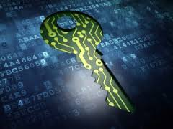
Clients can also use public keys to authenticate themselves to a server. An adversary who is able to compromise the private key for a client SSH authentication key can access the server by logging in as the client.
TLS and Diffie-Hellman. The TLS handshake begins with a negotiation to determine the crypto algorithms used for the session. The client sends a list of supported ciphersuites (and a random nonce cr) within the ClientHello message, where each ciphersuite specifies a key exchange algorithm and other primitives. The server selects a ciphersuite from the client’s list and signals its selection in a ServerHello message (containing a random nonce sr). The problems stem from the fact that the number field sieve for discrete log allows an attacker to perform a single precomputation that depends only on the group, after which computing individual logs in that group has a far lower cost.
If the client and server negotiate a Diffie-Hellman or elliptic curve Diffie-Hellman cipher suite, the server uses the public key in its certificate to sign its key exchange parameters to provide authentication. An adversary who knows the private key could carry out a man-in-the-middle attack by forging a correct signature on their desired parameters. If no 512-bit certificates are currently signed or trusted, such an active adversary could also merely replace the server certificate in the exchange along with the chosen Diffie-Hellman parameters. SSH hosts authenticate themselves to the client by signing the protocol handshake with their public host key. Clients match the host key to a stored trusted fingerprint. An adversary who is able to compromise the private key for an SSH host key can perform an active man-in-the-middle attack. We know to use 2048 bit-keys.

Slide 26
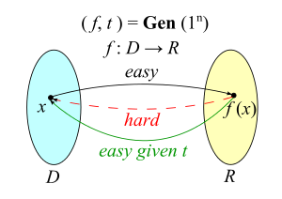
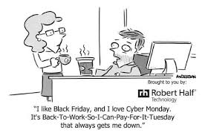
Key Management
Here's the fundamental problem: if an attacker knows the randomness you used to produce a ciphertext, then (in the worst case) she can simply encrypt 'guess' messages until she obtains the same ciphertext as you. At that point she knows what you encrypted.
The problem in a nutshell is that every ECDSA signature includes a random nonce value, which must never be repeated. If you ever forget this warning -- i.e., create two signatures (on different messages) using the same nonce -- then anyone can recover your secret key. This is both easy to detect, and to compute. You could write a script to troll the Internet for repeated nonces (e.g., in X509 certificates), and then outsource the final calculation to a bright eighth-grader.
http://cseweb.ucsd.edu/~tristenp/papers/detenc-rel.pdf

Slide 27
Embedded devices are well known to have entropy problems
Factorable public keys. More surprisingly, we discovered that entropy problems can allow a remote attacker with no special access to factor a significant fraction of the RSA keys in use on the Internet. We were able to factor 0.4% of the RSA keys in our SSL scan. We did this by computing the greatest common divisor (GCD) of all pairs of moduli from RSA public keys on the Internet.
Factorable public keys. More surprisingly, we discovered that entropy problems can allow a remote attacker with no special access to factor a significant fraction of the RSA keys in use on the Internet. We were able to factor 0.4% of the RSA keys in certain SSL scans. Researchers have performed this by computing the greatest common divisor (GCD) of all pairs of moduli from RSA public keys on the Internet.
If any pair of RSA moduli N₁ and N₂ share, say, the same prime factor p in common, but have different second factors q₁ and q₂, then we can easily factor the moduli by computing their greatest common divisor. On a desktop computer, computing the GCD of two 1024-bit RSA moduli took about 17µs.
The main mathematical insight is that one can compute the GCD of a single modulus N₁ with every other modulus N₂,…,N_{m} using the following equation:
gcd(N₁,N₂…N_{m}) = gcd(N₁, (N₁*N₂*…*N_{m} mod N₁²)/N₁)

Slide 28
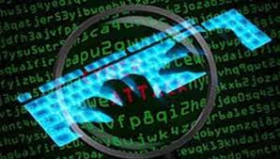
Widespread Weak Keys in DoD Networks and Mobile Devices
Randomness is essential for modern cryptography, where security often depends on keys being chosen uniformly at random.
Generate keys on first use, not on install or first boot
If the OS or cryptography library being used raises a signal that insufficient entropy is available (such as blocking), applications should detect this signal and refuse to perform security-critical operations until the system recovers from this potentially vulnerable state.
Frequently add entropy from the operating system.
Avoid factory-default keys or certificates.
Seed entropy at the factory.
Ensure entropy sources are effective.
Test cryptographic randomness on the completed mobile device.
Use hardware random number generators when possible.
Regenerate default or automatically generated keys.
Check for repeated, weak, and factorable keys.
Default to the most secure configuration.
Primitives should fail gracefully under weak entropy.

Slide 29


Entropy
If the pseudorandom number generator is seeded with a predictable value, then that would likely result in different devices generating the same modulus N, but we would not expect a good pseudorandom number generator to produce different moduli that share a single factor.
If the initial seed to the pseudorandom number generator is generated with low entropy, this could result in multiple devices generating different moduli which share the prime factor p and have different second factors q. Then both moduli can be easily factored by computing their GCD: p = gcd(N₁, N₂).
OpenSSL’s RSA key generation functions this way: each time random bits are produced from the entropy pool to generate the primes p and q, the current time in seconds is added to the entropy pool. Many, but not all, of the vulnerable keys were generated by OpenSSL and OpenSSH, which calls OpenSSL’s RSA key generation code.
http://cr.yp.to/papers.html#dcba

Slide 30

Juniper ScreenOS -- before the "unauthorized code"
The problem with this argument is that it assumes that no other code could ever "accidentally" exfiltrate a few bytes bit of raw Dual EC output. Yet this is exactly the kind of threat you'd worry about in a deliberately backdoored system -- the threat that, just maybe, the developers are not your friend. Thus Dual EC is safe only if you assume no tiny bug in the code could accidentally leak out 30 bytes or so of raw Dual EC output. If it did, this would make all subsequent seeding calls predictable, and thus render all numbers generated by the system predictable. In general, this would spell doom for the confidentiality of VPN connections. – Matt Green
You see, it turns out that some modern TLS clients -- including Apple's SecureTransport and OpenSSL -- have a bug in them. This bug causes them to accept RSA export-grade keys even when the client didn't ask for export-grade RSA. The impact of this bug can be quite nasty: it admits a ‘man in the middle' attack whereby an active attacker can force down the quality of a connection, provided that the client is vulnerable and the server supports export RSA.
Dual EC DRBG
Thus what comes out from this function is 32 bytes of raw Dual EC output, which is all you need to recover the internal Dual EC generator state and predict all future outputs.
https://rpw.sh/blog/2015/12/21/the-backdoored-backdoor/
https://kb.juniper.net/InfoCenter/index?page=content&id=KB28205&pmv=print&actp=LIST

Slide 31
We Are Supporting Digital Credentials
We are working with COTS partners on end-to-end solutions
We are building capabilities for commercial platforms for UNCLASS and CSfC
We are making certificate-based security easy for app developers
We support secure device enrollment protocols (EST) as well as the less-secure SCEP for DoD PKI on approved CMDs
We propose to partner with all Navy and Marine Corps commands as well as NSA and OSD CIO’s office on advanced credential-based security for approved CMDs
The trust for the new credential is derived by the strong identity binding associated with the authenticated PIV smartcard during enrollment. It is important to note that only the trust is derived during enrollment; certificates themselves are cryptographically unique from the user’s PIV credentials.

Slide 32
Potential Statement of Work for N81
Problem Statement
Traditional DoD authentication methods of username and password do not work very well for either the Warfighter who may have difficulty remembering complex passwords or the MilDep enterprise provider (usually referred to as the relying party) who may need to factor in the risk that the password has been compromised.
On NIAP approved commercial mobile devices new protocols can be used with biometric authenticators to enable services with the swipe of a fingerprint or the scan of an iris. We propose to use FIDO developed new protocols that will enable simple, strong authentication between the user, their device and the relying party.
We propose to (a) separate the user authentication method from the authentication protocol and (b) to define an attestation method in order to proof the FIDO Authenticator type to the relying party.

Slide 33
Attestation
Using hardware attestation is not new. In the DoD Public Key Infrastructure (PKI), the hardware verification is typically being performed by the Certificate Authority before issuing the user certificate. The device policy is typically included into the user certificate as Certificate Policy OID (e.g. “id-fpki-certpcy-pivi-hardware” in the case of Federal PKI Bridge CA, see (Federal Public Key Infrastructure Policy Authority, 2011)). User registration/identification and hardware attestation are combined into a single certificate. Relying parties verify such certificate policies included in the user certificate when validating the user derived PKI certificates.
As an example, TPMs, specified by TCG and Global Platfrom, dene security interfaces for non-volatile storage, key generation and use, and binding locally encrypted data to the measured software configuration of the device (sealing). The recently published TPM 2.0 specification adds a fine-grained policy authorization model for object access. The TPM is typically implemented as a discrete chip, but in a mobile context a trusted application implementation is more likely deployment. TPM interfaces do not specify installation of trusted applications into TEE. There is an integrity issue now with ARM (Japanese owned) so we need small COTS companies with smart Americans to mitigate this new risk.

Slide 34
PUF- Physical Unclonable Functions
The vulnerability in traditional hardware security systems that use a cryptographic key hidden in the device itself. While these solutions use a variety of hardware, software and other encryption measures to protect this key from discovery, ultimately the hardware is only as secure as the secret key protecting it. Authentication relies on a private key hidden in the secure memory of the TrustZone or embedded secure element (eSE) of the TEE. Key protection, such as SRAM PUF can protect application keys or other critical user assets in a way that is more secure than just storing the key in NV memory. PUF technology can serve as a root of trust, implementing the source for the memory encryption.

Slide 35
Threat Landscape
The design of security architecture conventionally relies on two basic concepts: the principle of least privilege, and the partitioning of the system into protected compartments. For example, the TrustZone based TEE is normally designed to maintain its isolation even if the Normal World has been compromised. A malicious hacker may take over the Normal World and spy on communications to the TEE, but the Trusted World will retain its integrity and confidentiality.

Slide 36
Navy Implementation Use Cases
1. To ensure the integrity of the device: This is achieved using hardware roots of trust and a TrustZone isolated authenticated trusted boot process.
2. To keep key material confidential from unauthorized access: The Navy enterprise system wide hardware isolation provided by the TrustZone architecture extensions enables a small, security certifiable TEE to handle key materials. FIDO keys can themselves be encrypted using strong cryptography and fused Hardware Unique Keys.
3. To maintain the confidentiality and integrity of sensitive processes: The TEE provides the security promises of integrity and confidentiality. Typically, small parts of the FIDO process will be statically partitioned into the Trusted World and run as a Trusted Application.
4. To maintain the confidentiality of sensitive input data: TrustZone enables interrupts from input devices (such as authenticators) to be steered directly to the Trusted World where trusted device drivers can handle them. For example, the TEE can handle touch events from a touchscreen during PIN capture or interrupts from a fingerprint sensor and separate it from malware in the normal world that would not be able to intercept it. When the PIN capture or other input is complete the interrupts can be switched back to the normal world.
5. Protection of sensitive display data: TrustZone can be used to protect a Trusted World frame-buffer and its composition. This enables a “what you see is what you sign/buy” feature since the frame-buffer cannot be intercepted, modified or obscured.

Slide 37
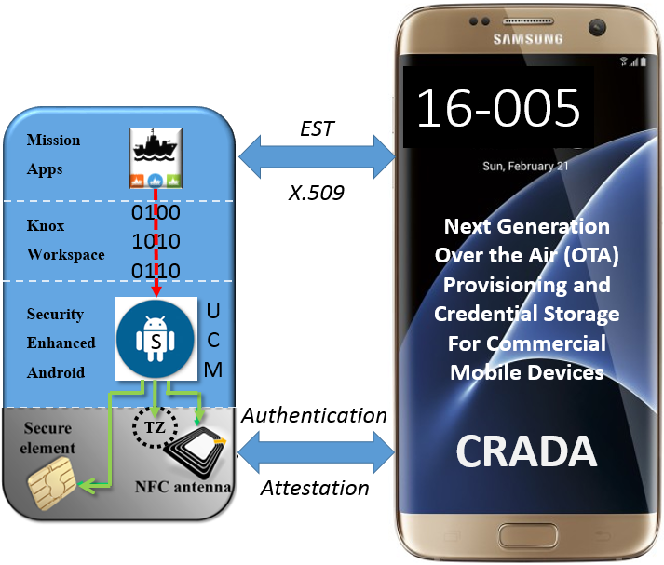
Navy – Samsung CRADA

Slide 40
FY16
Research Study/Analysis of FIDO UAF Authenticator requirements (FIDO UAF
protocol)
Research/Analysis of EMVCo payment tokenization technology
Conduct CRADA integration, planning, developmental use case activities for
N81 requirements
FY17
Architecture design/modification to support FIDO requirements and EMVCo
payment tokenization technology
Update test environment and test harnesses to support FIDO/EMVCo
Requirements
EST Server Development and Testing to support FIDO UAF token provisioning
Acquire, integrate and test COTS FIDO Server, or develop extension to EST
Server or stand-alone component to support FIDO UAF attestation, communicate
protocol messages, authentication of transactions, and account management
EST Server Development and Testing to support EMVCo use cases

